Slide 1
VIDYA ~ एक कोशिश
Project Concepts

Slide 2



Meet Our Team
SAUMYA AGRAWAL
VISHVENDRA SINGH
AYUSH SONI
Project Owner
Head of Design
Scrum Master

Slide 3

ABSTRACT
VIDYA IS TO HANDLE DONATIONS AND CONNECT THE DONARS WITH THE NEAREST/APPROPRIATE NEEDY THROUGH A SOCIAL MOBILE APPLICATION.
THE APPLICATION HANDLES DIFFERENT SERVICES SUCH AS THE REVIEWS OF THE SEARCHED NEEDY PERSON AND DISPLAYS THEIR CONTACTS AND THEIR LOCATION THE APPLICATION ALLOWS USERS TO CREATE A PROFILE FOR THEMSELVES AND THE INFORMATION ABOUT THE NEEDY.

Slide 4

VIDYA
एक कोशिश
An Introduction
This application is aimed to help the Moroccan society and create a sense of solidarity through modern techniques. The social implications it will have after being launched will certainly aim at closing the gap in terms of quality of life for the less fortunate citizens.

Slide 5
Children living in poverty face many barriers to accessing an education. Some are obvious — like not having a school to go to — while others are more subtle, like the teacher at the school not having had the training needed to help children learn effectively.
PROBLEM STATEMENT

Slide 6
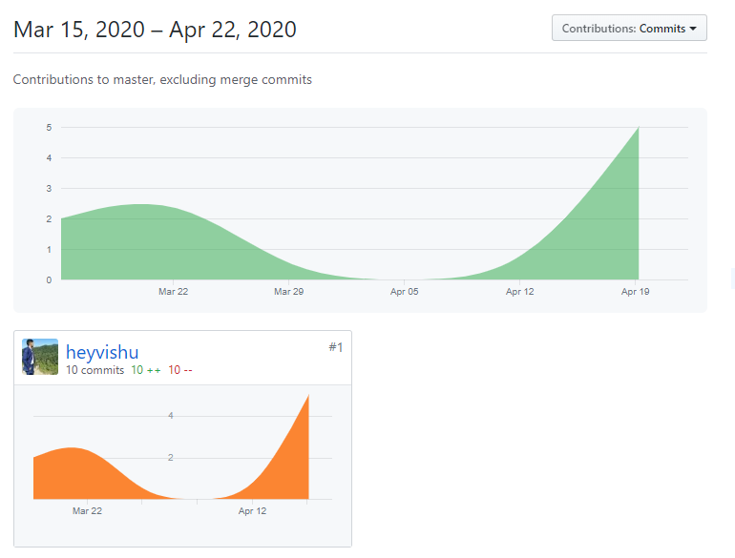
Our
GIT
Hub
Activity

Slide 7
NO
10%
DATA ANALYSIS
Is our project helping you to achieve your goal ?
YES
90%

Slide 8
OKAY
5%
What would you rate our startup ?
GOOD
15%
EXCELLENT
40%
GREAT
40%

Slide 9

Target Audience
An organization which aims at bringing people together and also creating a platform where people from similar domains
can collaborate and work together. It is also a marketplace to sell books and subject notes at a very reasonable price. The whole idea behind this project is to provide people in need
with a platform where their basic educational requirements
can be fulfilled.
1. Necessitous/Poverty
2. Carrier counseling/guidance
3 Making society cerebral

Slide 10
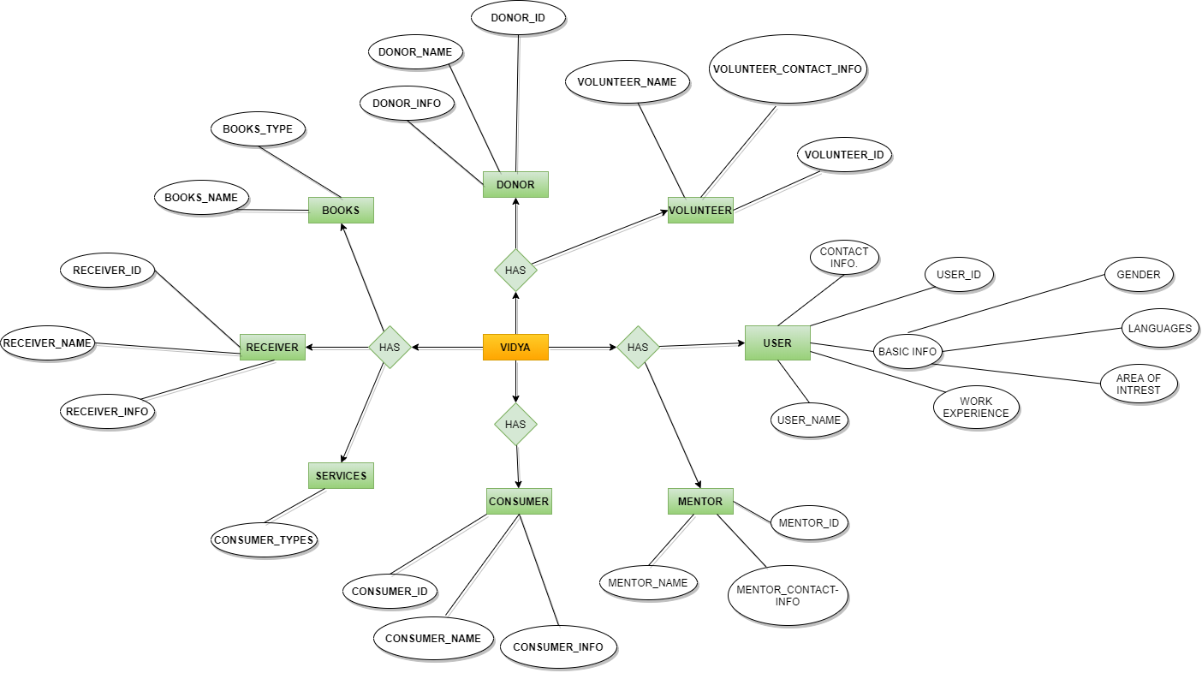
ERD

Slide 11
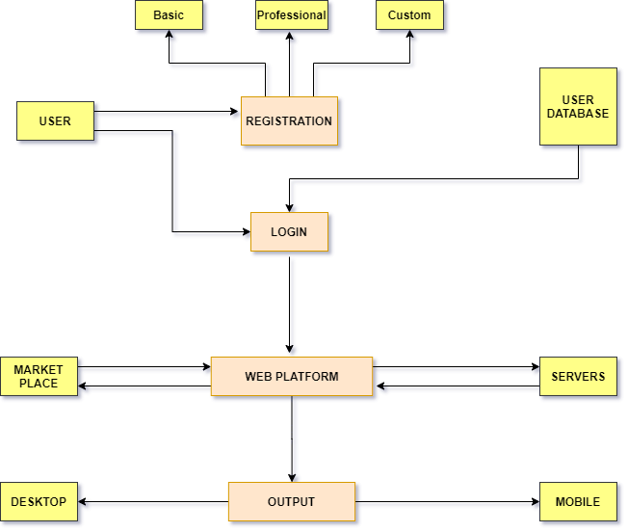
Data Flow Diagram (DFD)
LEVEL - 2

Slide 12
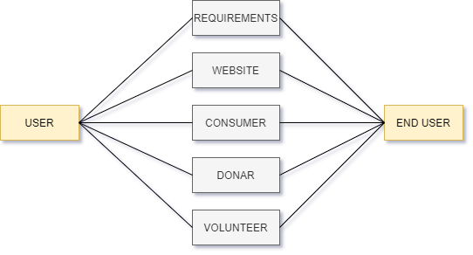
Data Flow Diagram (DFD)
LEVEL - 2

Slide 13
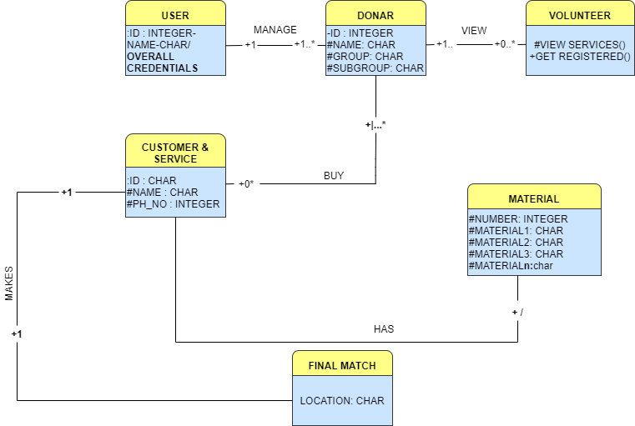
Class Diagram

Slide 14
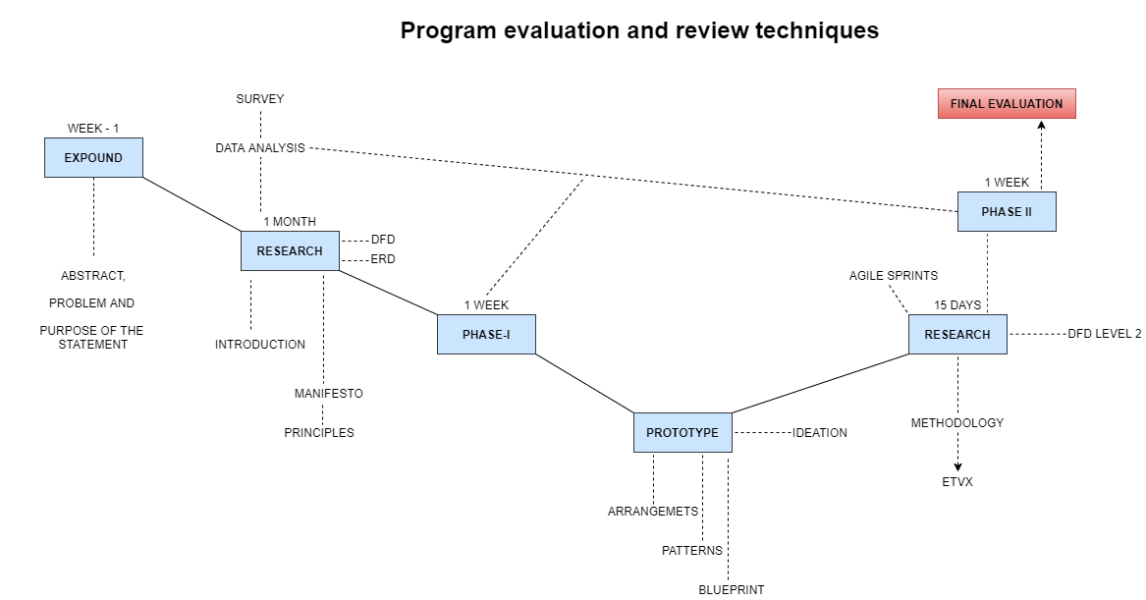
PERT CHART

Slide 15
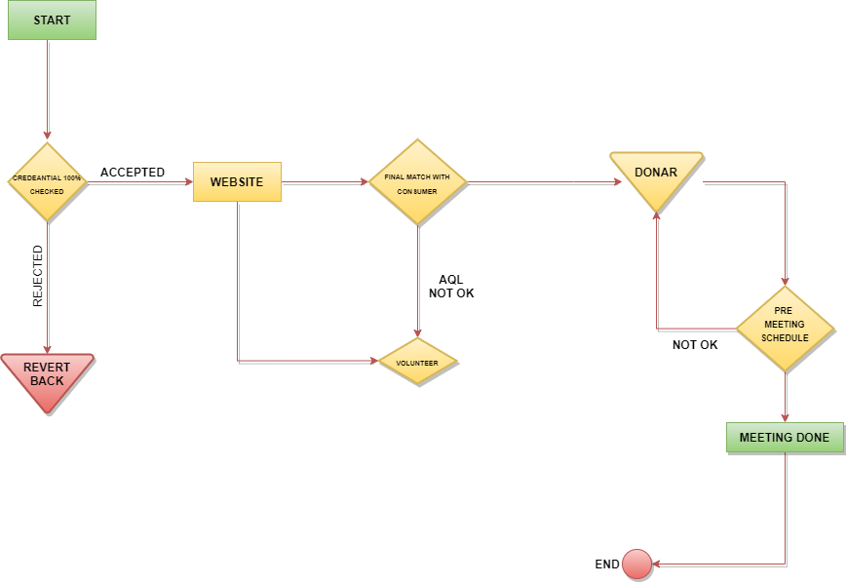
PROCESS FLOW CHART

Slide 16
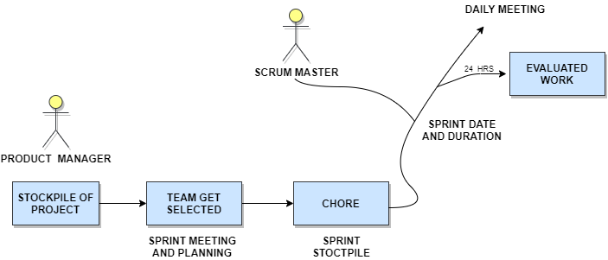
SCRUM FRAMEWORK

Slide 17
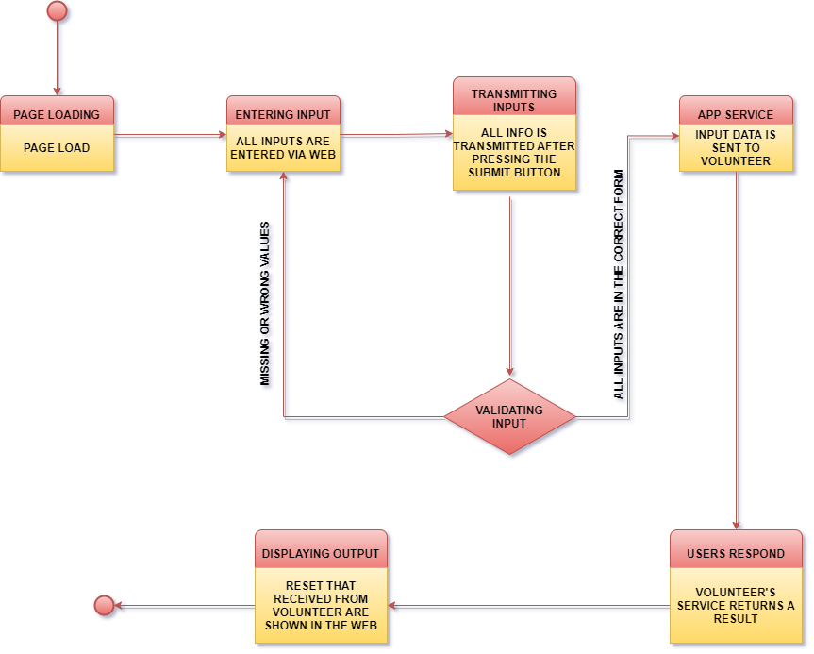
STATE CHART

Slide 18

Thank you.
Team - Vidya

Slide 19


TELEPHONE
+91 9460919564
EMAIL
edgy_eft9@protonmail.com
Let's talk!
FB/VIDYA.EK
IG/FB/VIDYA.EK

